Slide 1

🐳 Ultimate Docker Cheatsheet
An ultimate cheatsheet for Docker developers: commands, concepts, and best practices at your fingertips.

Slide 2


Basic Commands
docker --version
docker --help
Check Docker version installed
Display help for Docker commands
docker info
Show detailed Docker system information

Slide 3
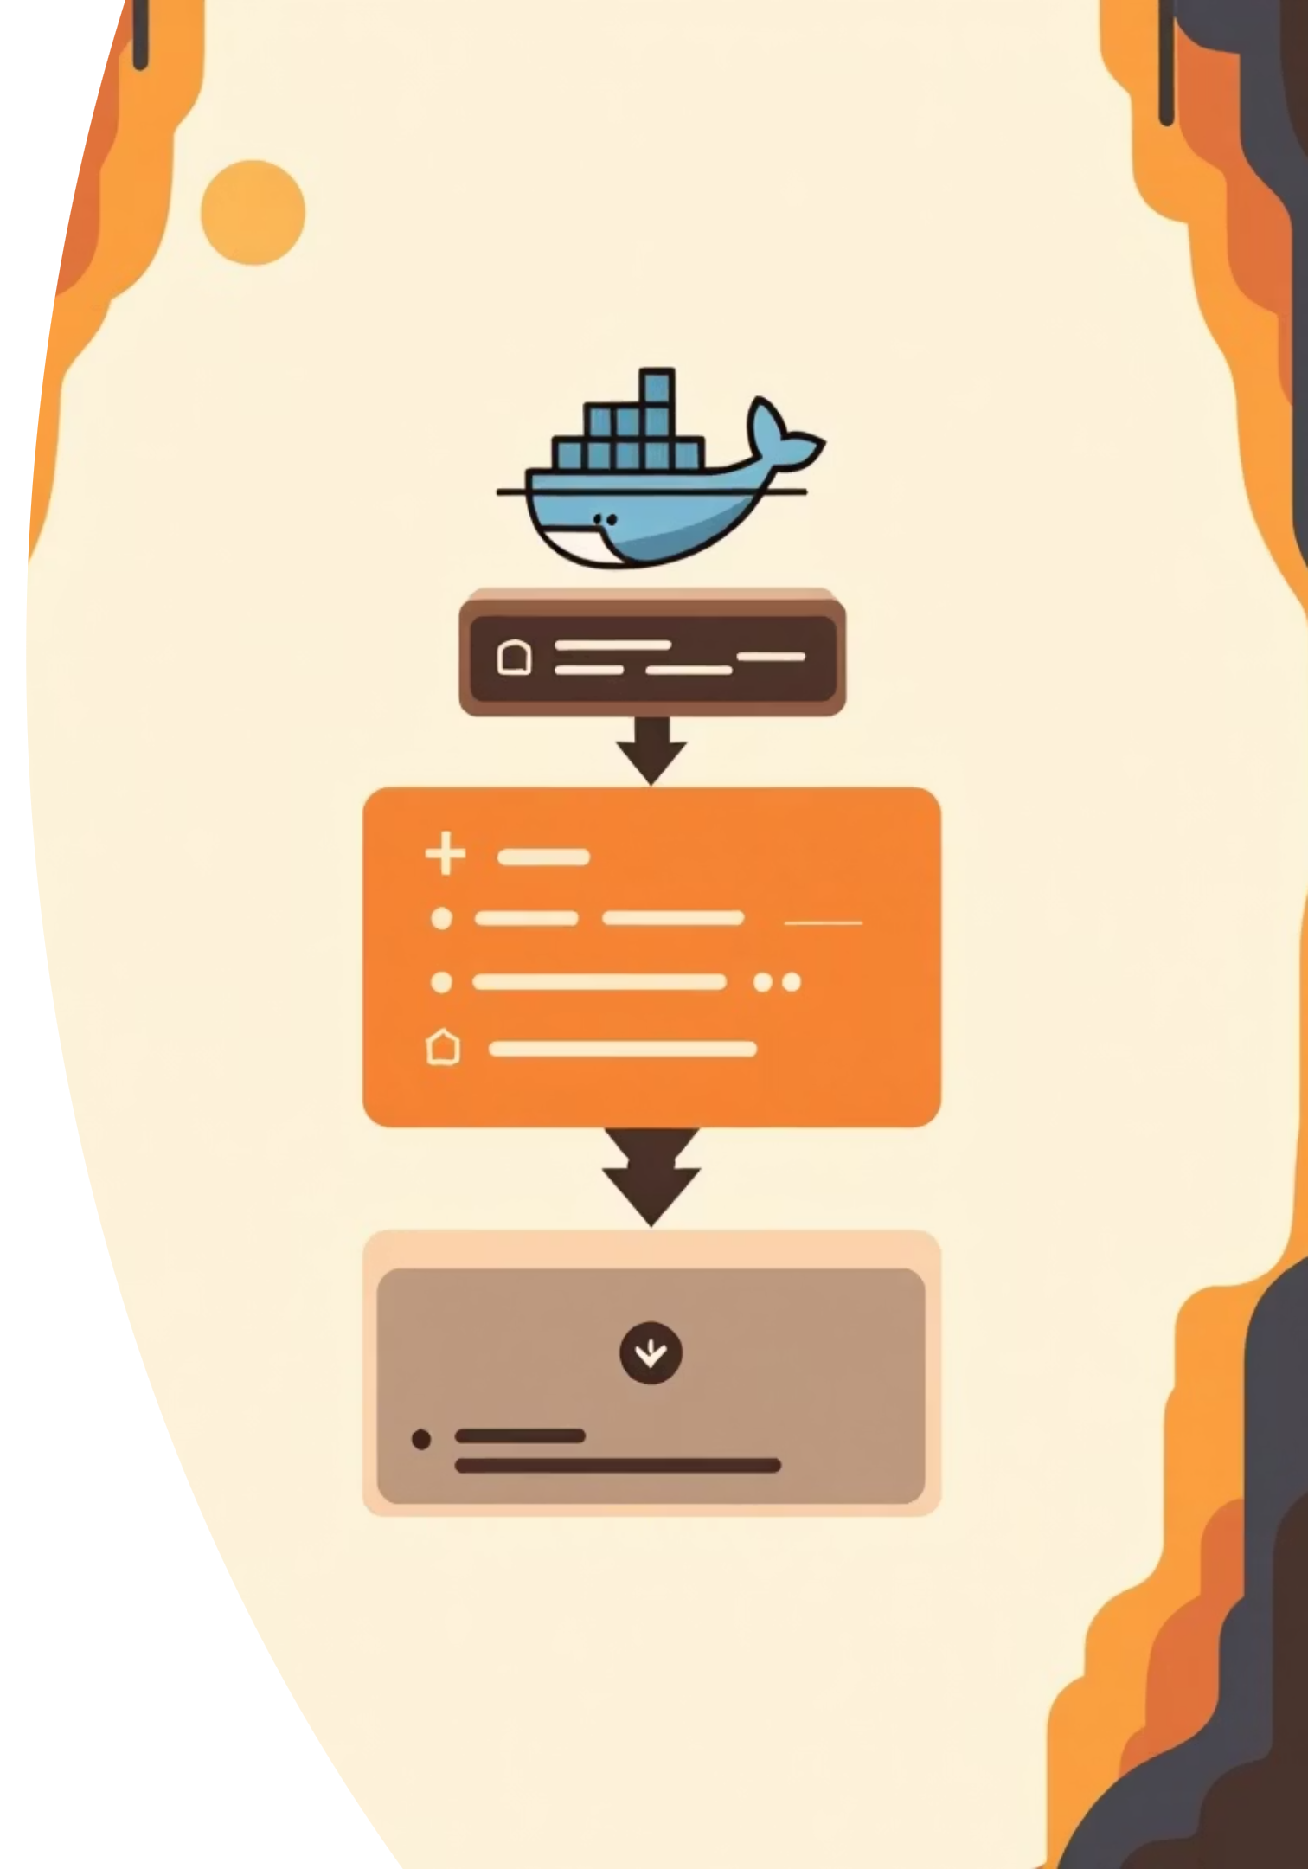
Images
Core Image Commands
Advanced Operations
docker images - List all Docker images
docker inspect <image_id> - View detailed info
docker pull <image> - Download from registry
docker save -o <file.tar> - Save to archive
docker rmi <image_id> - Remove an image
docker load -i <file.tar> - Load from archive
docker build -t <name> . - Build from Dockerfile
docker export -o <file.tar> - Export container
docker tag <src> <name>:<tag> - Tag an image
docker import <file.tar> - Create from archive

Slide 4

Containers
List & View
1
docker ps - Running containers
docker ps -a - All containers
docker logs <container> - Fetch logs
Run & Execute
2
docker run <image> - Run container
docker run -d <image> - Run detached
docker exec -it <container> <cmd> - Execute command
Control
3
docker start/stop/restart - Manage state
docker pause/unpause - Pause processes
docker kill - Force stop immediately
Manage
4
docker rm <container> - Remove container
docker rename <old> <new> - Rename
docker commit - Create image from changes

Slide 5





Volumes
Create
List & Inspect
docker volume create <vol>
docker volume ls
Create a named volume for persistent data storage
docker volume inspect <vol>
View all volumes and their details
Mount
Remove
docker run -v <vol>:<path>
docker volume rm <vol>
Mount volume into container at specified path
Delete a volume permanently

Slide 6






Networks
Create Network
Connect Container
docker network create <net>
docker network connect <net> <container>
Remove Network
Inspect Details
docker network rm <net>
docker network inspect <net>
List Networks
Disconnect
docker network ls
docker network disconnect <net> <container>

Slide 7
Dockerfile Commands
01
02
03
FROM <base>
RUN <cmd>
COPY <src> <dest>
Specify base image
Run command at build time
Copy files/directories
04
05
06
ENV <key>=<val>
EXPOSE <port>
WORKDIR <path>
Set environment variable
Declare listening port
Set working directory
07
08
09
USER <user>
CMD ["exe", "param"]
ENTRYPOINT ["exe"]
Set user
Default command for container
Container's main executable

Slide 8

Docker Compose
docker-compose up
docker-compose down
docker-compose logs
docker-compose scale
Start services in foreground
Stop & remove containers, networks
View service logs
Scale a service: <svc>=<n>
-d flag: Run in background
Pro tip: Use docker-compose ps to list services and docker-compose restart to restart them quickly.

Slide 9

Docker Swarm
Initialize & Join
docker swarm init - Initialize swarm manager
docker swarm join --token <t> <mgr> - Join node to swarm
docker node ls - List nodes in swarm
Service Management
docker service create <opts> <image> - Create & deploy service
docker service scale <svc>=<n> - Scale replicas
docker service rm <svc> - Remove service
docker service inspect <svc> - Show details

Slide 10

Registry
Login
Pull
docker login <registry>
docker pull <image>
Authenticate to registry
Download image from registry
1
2
3
4
Push
Logout
docker push <image>
docker logout <registry>
Upload image to registry
End registry session
Master these Docker commands to streamline your containerization workflow and boost productivity.

Slide 11
Troubleshooting
Command
Description
docker logs <container>
View container logs
docker inspect <obj>
Detailed info (container/image/volume/network)
docker system df
Display disk usage by Docker objects
docker system prune
Remove all unused containers, images, networks
docker container prune
Remove stopped containers
docker image prune
Remove dangling images
docker network prune
Remove unused networks

